Slide 1
Big MART SALES PREDICTION
BY ujwaL TALELE

Slide 2
overview
The Problem
Data
Visual Inspections
Some feature engineering
Regression
Conclusions and Next Steps

Slide 3
The problem
The data scientists at BigMart have collected 2013 sales data for 1559 products across 10 stores in different cities. Also, certain attributes of each product and store have been defined. The aim is to build a predictive model and predict the sales of each product at a particular outlet.
Using this model, BigMart will try to understand the properties of products and outlets which play a key role in increasing sales.

Slide 4
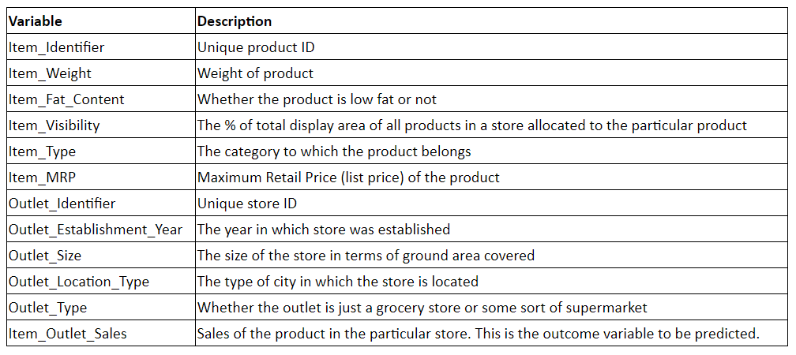
Data

Slide 5
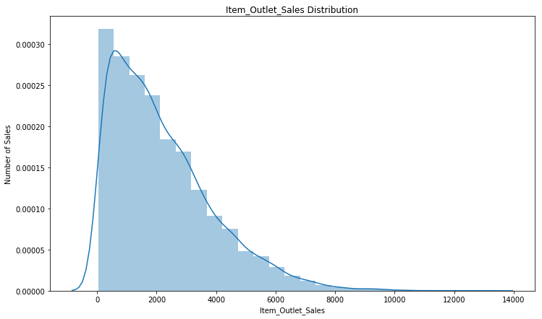
Visual inspections
The sale is right skewed, shows that most of the costumers are nominal shoppers.

Slide 6
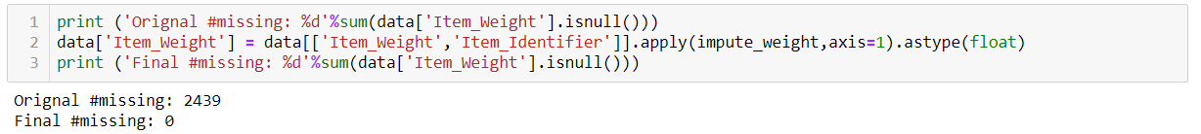
Feature engineering
IMPutations
Categorical Encoding
Three columns had missing values , they were filled by using their relation with other variables in the dataset
As none of the feature was having high cardinality other than `Item_ID`, all other categorical features were converted to dummy variables.

Slide 7
Regression
Algorithm | RMSE Score
Linear Regression | 1127.38
Ridge Regression | 1181.22
XGBoost | 908.27
Created a baseline model with simple regression algorithms.

Slide 8
Conclusion and improvements
What did we learn?
Improvements that can be done
With very minimal feature engineering XGboost gives the least RMSE making it the best performing algorithm.
The deviation in the result ig the model was to be deployed will be +- 1%
Find best parameters by hyperparameter tuning
Some more work on feature engineering.
Model took a lot of time in training, try to do feature elimination and reduce the time.

